Slide 1
WOMEN’S POLITICAL PARTICIPATION AND LEADERSHIP ASSESSMENT: HONDURAS
Findings Presentation
Date: 2023

Slide 2
AGENDA
-Assessment Purpose & Approach
-Methodology
-Barriers & Opportunities
-Recommendations

Slide 3
ASSESSMENT PURPOSE & APPROACH
The study of women’s political leadership in Honduras investigated the barriers to and opportunities for expanding women’s participation and leadership in the political landscape.
It used the Women’s Political Participation and Leadership (WPPL) Assessment Framework to document women’s access to and power in politics along sociocultural, institutional, and individual dimensions.
The assessment analyzed WPPL through the lenses of access and power.
USAID can use the report’s findings to identify priority areas where its investments are likely to have the greatest impact.
Notes:
Provide brief background on the framework – highlighting what audience needs to know to follow presentation. Can abbreviate further if audience is assumed to be familiar.

Slide 4
METHODOLOGY
Desk Review
Key Informant Interviews
Eleven civil society leaders (nine women, two men)
Fourteen politicians (five women, nine men)
Fifteen donors (seven women, eight men)
Three political leaders (one woman, two men)
Three men electoral officers
Notes:
Details include geographic coverage, number of surveyed politicians, number and type of KIIs, number and type of FGDs.

Slide 5
METHODOLOGY—FOCUS GROUP DISCUSSIONS
NO. | GROUP DESCRIPTION | LOCATION | TOTAL PARTICIPANTS
1 | Women in civil society | Tegucigalpa | 10
2 | Men political leaders, currently in congress | Tegucigalpa | 3
3 | Locally elected women | Tocoa | 12
4 | Men in media | Tegucigalpa | 7
5 | Locally elected women | La Ceiba | 8
6 | Young women in civil society | Tegucigalpa | 5
7 | Young women in political parties | Tegucigalpa | 5
8 | Women in politics | Tegucigalpa | Did not happen

Slide 6
METHODOLOGY—SURVEY
POLITICAL PARTY | GENDER | NO. OF SURVEYS
Libre | Women | 1
 | Men | 2
Partido Liberal | Women | 2
 | Men | 3
Partido Nacional | Women | 3
 | Men | 3
Partido Salvador de Honduras | Women | 1
 | Men | 3
PINU | Women | 0
 | Men | 1

Slide 7
BARRIERS & OPPORTUNITIES

Slide 8
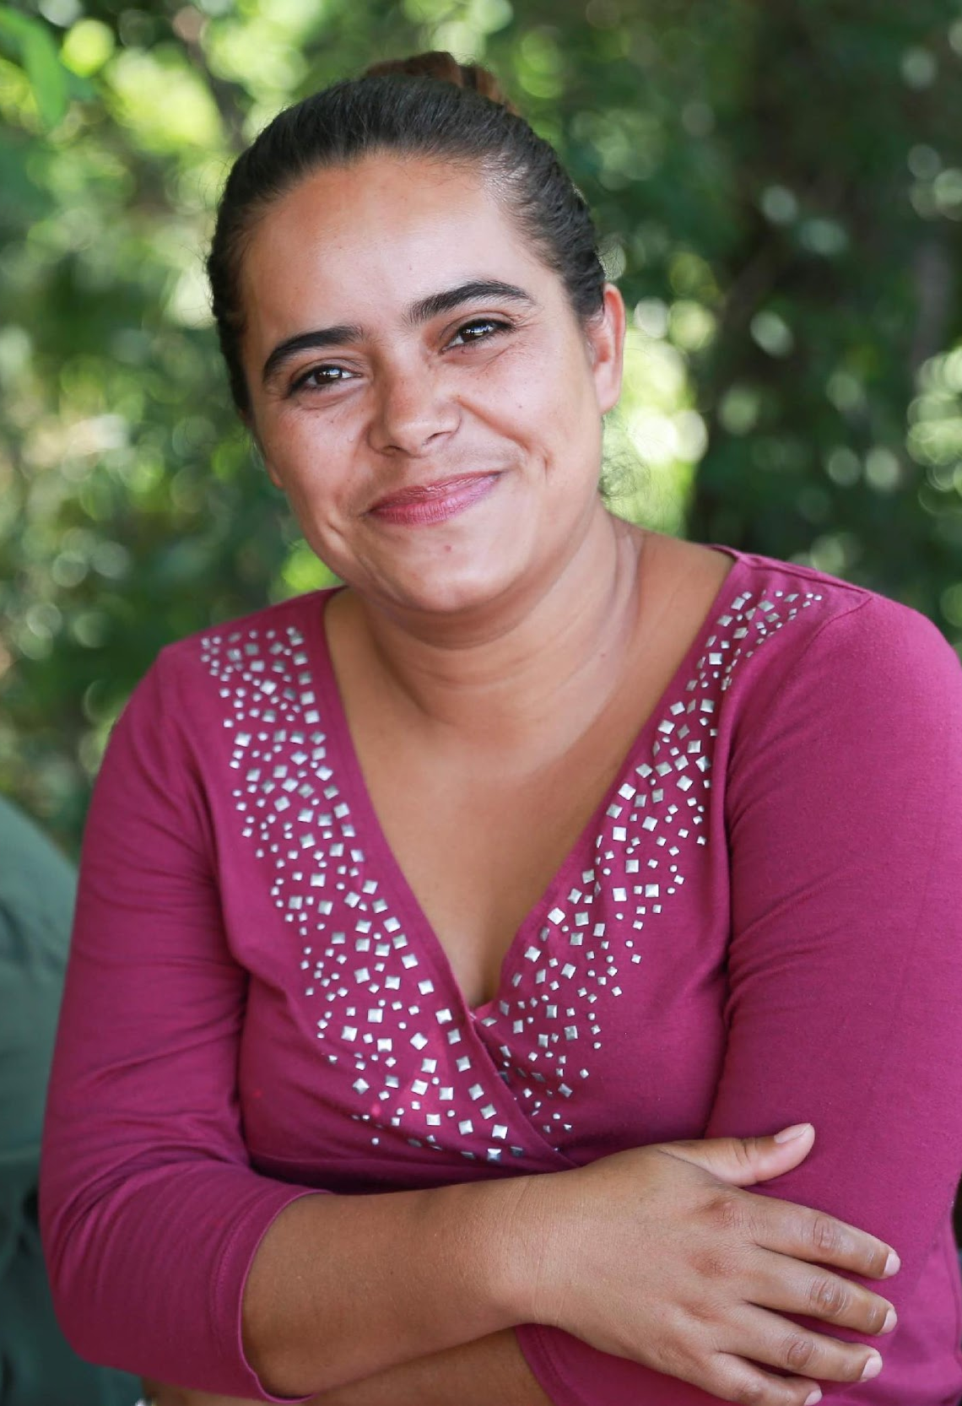
SOCIOCULTURAL
Barriers
Patriarchal culture
Religious beliefs
Sociocultural norms
Stigma against women in political life
Opportunities
Women in civil society

Slide 9
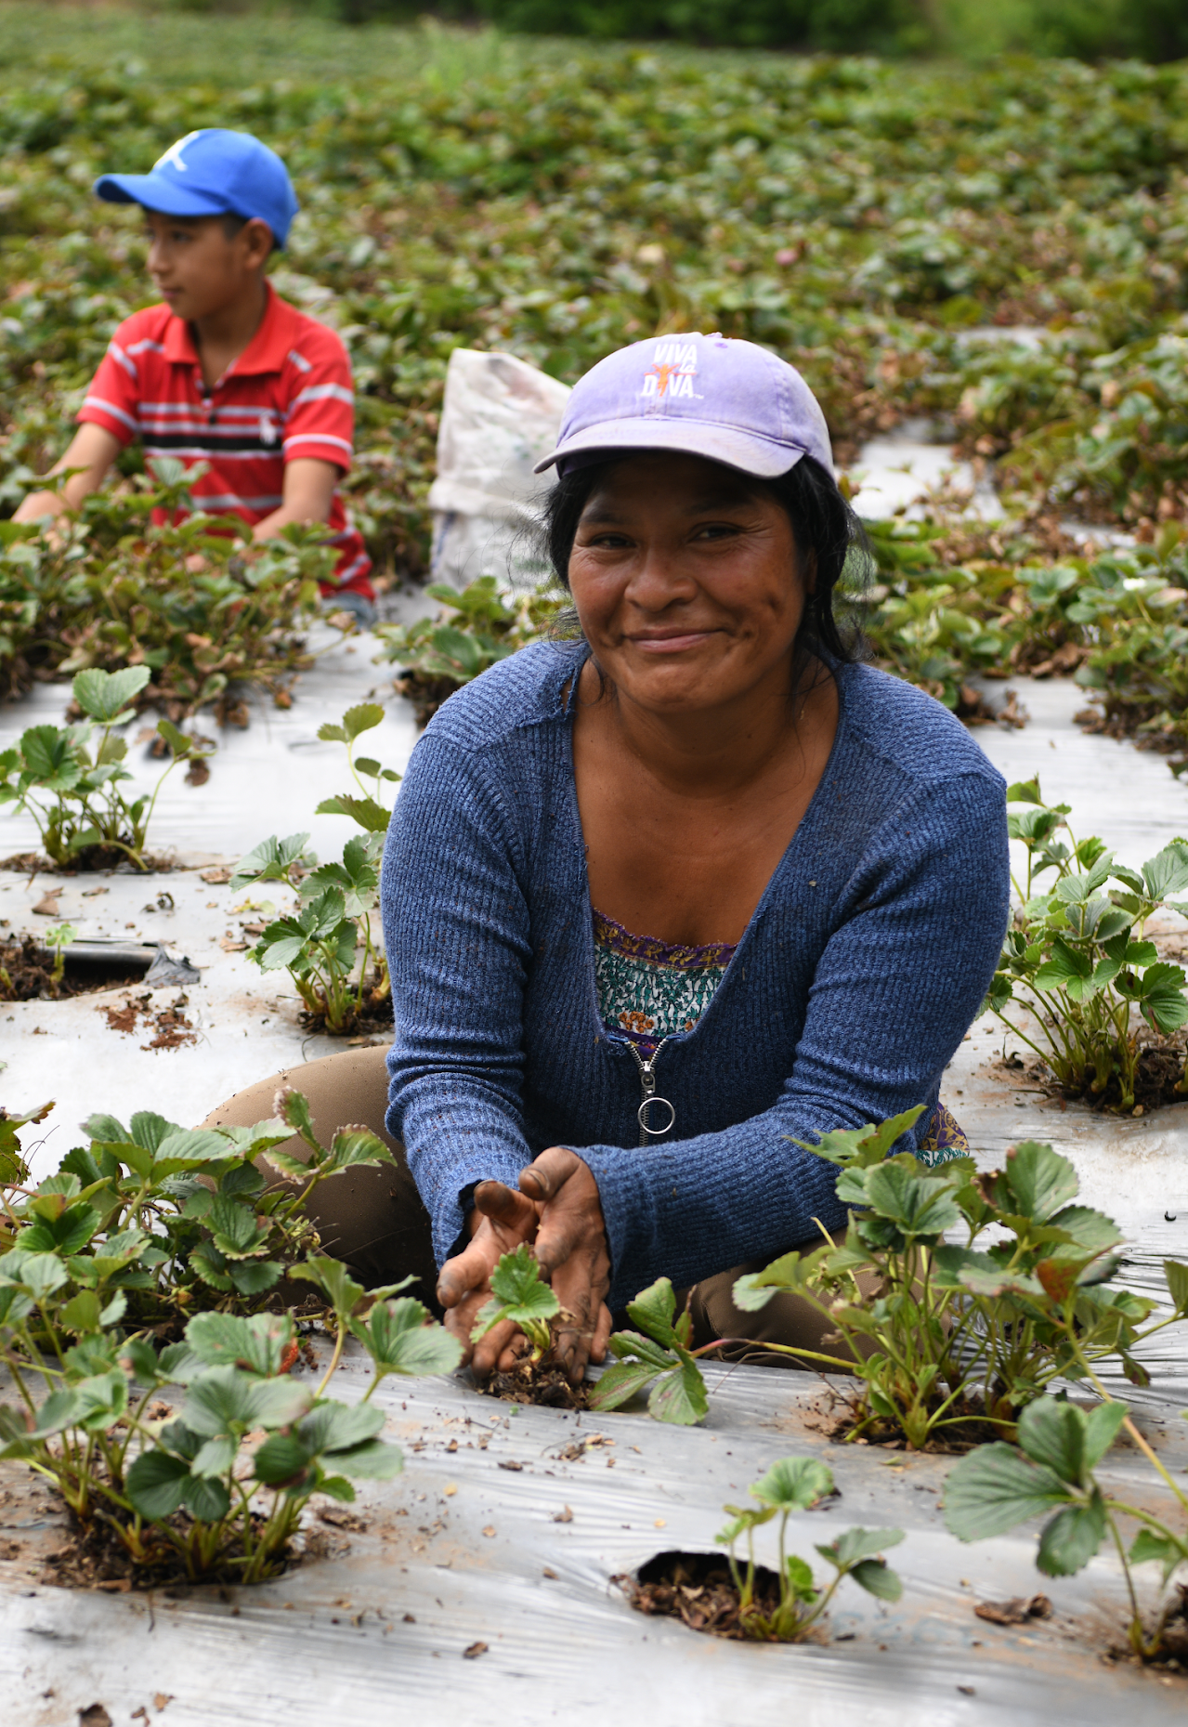
INSTITUTIONAL
Barriers
Violence against women in politics
Elected women leaders
Political parties
Opportunities
Legal framework
Government institutions

Slide 10
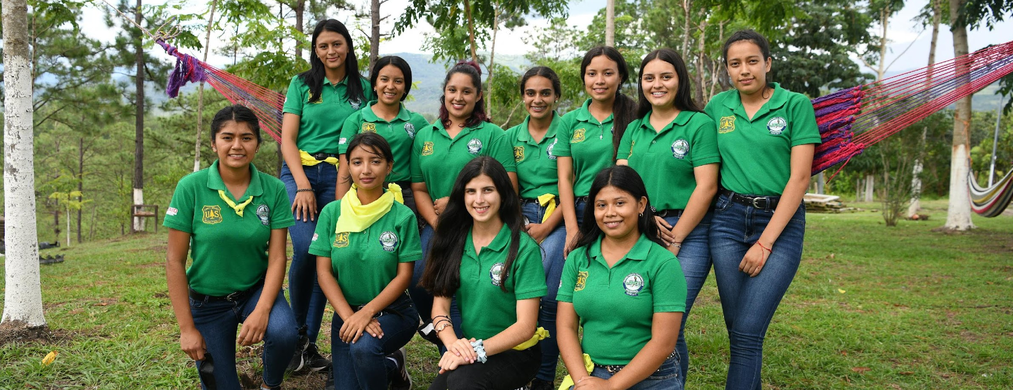
INDIVIDUAL
Barriers
Access to funding
Lack of capacity and confidence
Family support

Slide 11
RECOMMENDATIONS

Slide 12
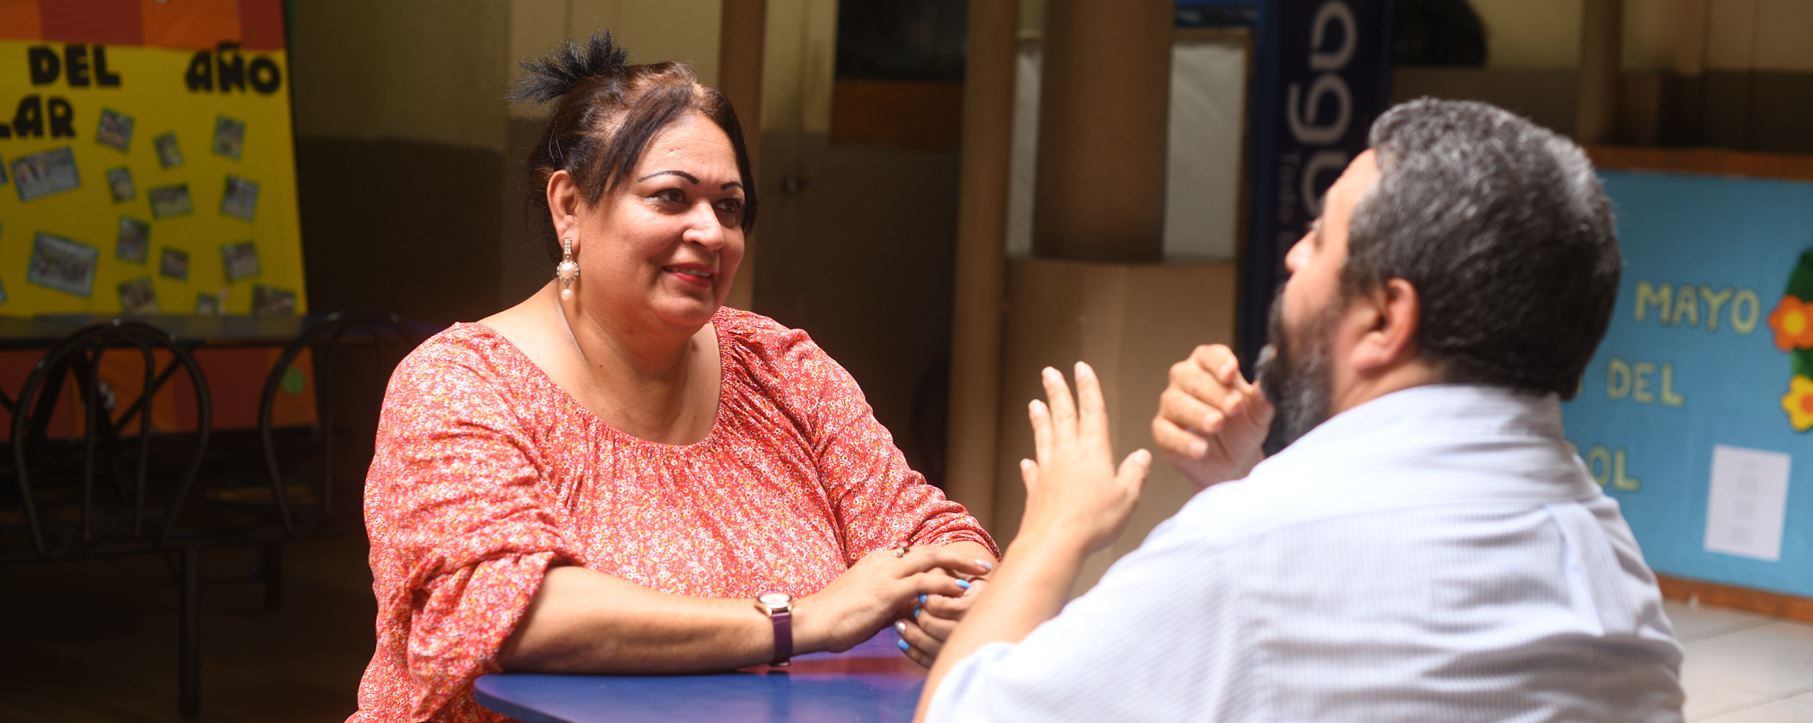
SOCIOCULTURAL
Work with men, including political and church officials, to shift harmful cultural beliefs and practices
Provide journalist training for media professionals on how to cover women in politics in a gender-transformative way

Slide 13
INSTITUTIONAL
Review and revise the national electoral laws
Develop and implement more rigorous measures to monitor compliance with the provisions of the law pertaining to gender equality
Provide technical assistance to political parties
Strengthen civil society organization coordination and advocacy efforts around passing laws to address violence targeting women in politics and public life

Slide 14
INSTITUTIONAL (cont.)
Dedicate funding to support women’s wings of political parties
Develop policies and protocols in Congress and political parties that are sensitive to the needs and experiences of Honduran women
Mainstream gender considerations
Stand up a gender unit in the CNE
Support local CSOs
Combat gender-based violence

Slide 15
INDIVIDUAL
Train locally elected women leaders
Create gender-sensitive civic education programs
Support youth committees of national political parties
Develop leadership and capacity-building programs for civil society and women in rural and urban contexts
Provide candidate training to women running for office

Slide 16
QUESTIONS?

